Slide 1
ITP20005 LOO
Type Checking
JC

Slide 2
Semantics Exercise
Recursion [aRecSub (name symbol?) (value-box (box/c RCFAE-Value?)) (ds DefrdSub?)]) [rec (bound-id named-expr first-call) (local [(define value-holder (box (numV 198))) (define new-ds (aRecSub bound-id value-holder ds))] (begin (set-box! value-holder (interp named-expr new-ds)) (interp first-call new-ds)))]
{fun {i} b},ε ⇒ <i,b,ε'> a,ε ⇒ a_{v} b,ε''[f← (<i,b,ε'>),i← a_{v}] ⇒ b_{v} {rec {f {fun {i} b}} {f a}},ε ⇒ b_{v}

Slide 3
Semantics Exercise
Recursion [aRecSub (name symbol?) (value-box (box/c RCFAE-Value?)) (ds DefrdSub?)]) [rec (bound-id named-expr first-call) (local [(define value-holder (box (numV 198))) (define new-ds (aRecSub bound-id value-holder ds))] (begin (set-box! value-holder (interp named-expr new-ds)) (interp first-call new-ds)))]
f,ε ⇒ <i,b,ε'> a,ε ⇒ a_{v} b,ε''[f← (<i,b,ε'>),i← a_{v}] ⇒ b_{v} {rec {f {fun {i} b}} {f a}},ε ⇒ b_{v}

Slide 4
Semantics Exercise
Recursion [aRecSub (name symbol?) (value-box (box/c RCFAE-Value?)) (ds DefrdSub?)]) [rec (bound-id named-expr first-call) (local [(define value-holder (box (numV 198))) (define new-ds (aRecSub bound-id value-holder ds))] (begin (set-box! value-holder (interp named-expr new-ds)) (interp first-call new-ds)))]
f ⇒ <i,b,ε'> a,ε ⇒ a_{v} b,ε''[f← (<i,b,ε'>),i← a_{v}] ⇒ b_{v} {f a},ε ⇒ b_{v}

Slide 5
Type Checking

Slide 6
No type cases
{+ {fun {x : num} x} 3}: no type
{7 5} : no type
code → (Parser) → code in AST → (Interpreter) -> Result
code → (Parser) → code in AST → (type checker) → (Interpreter) → Result

Slide 7
TFAE Grammar
e ::= n | {+ e e} | {- e e} | x | {fun {x:τ} e} | {e e} τ :: = num | bool | (τ -> τ)

Slide 8
TFAE Expressions
← How to install plai-typed: https://lists.racket-lang.org/users/archive/2013-August/059187.html
# lang plai-typed
; abstract syntax tree (AST) for TFAE (define-type TFAE [num (n : number)] [add (lhs : TFAE) (rhs : TFAE)] [sub (lhs : TFAE) (rhs : TFAE)] [id (name : symbol)] [fun (param : symbol) (type : TE) (body : TFAE)] [app (fun-expr : TFAE) (arg-expr : TFAE)])

Slide 9
TFAE Expressions and Types
(define-type TE [numTE] [boolTE] [arrowTE (arg : TE) (result : TE)]) (define-type Type [numT] [boolT] [arrowT (arg : Type) (result : Type)]) (define-type TypeEnv [mtEnv] [aBind (name : symbol) (type : Type) (rest : TypeEnv)])

Slide 10
Type Check and Interpret
typecheck and interp (define eval : (TFAE -> TFAE-Value) (lambda (tfae) (begin ;; before calling interp, we can do type checking ;; based on our rules. (try (typecheck tfae (mtEnv)) (lambda () (error 'type-error "typecheck"))) (interp tfae (mtsub)))))

Slide 11
Type Check and Interpret
; typecheck : TFAE TypeEnv -> Type (typecheck tfae env) = t Γ ⊦ e : τ
; interp : TFAE DeferdSub -> TFAE-Value (interp tfae ds) = v σ ⊦ e ⇒ v

Slide 12
TFAE Type Checker
(define typecheck : (TFAE TypeEnv -> Type) (lambda (tfae env) (type-case TFAE tfae …)))

Slide 13
TFAE Type Checker
(define typecheck : (TFAE TypeEnv -> Type) (lambda (tfae env) (type-case TFAE tfae [num (n) …] …))) Γ ⊦ n : num

Slide 14
TFAE Type Checker
(define typecheck : (TFAE TypeEnv -> Type) (lambda (tfae env) (type-case TFAE tfae [num (n) (numT)] …))) Γ ⊦ n : num

Slide 15
TFAE Type Checker
(define typecheck : (TFAE TypeEnv -> Type) (lambda (tfae env) (type-case TFAE tfae [add (l r) … (typecheck l env) … … (typecheck r env) … ] …))) Γ ⊦ e₁ : num Γ ⊦ e₂ : num Γ ⊦ {+ e₁ e₂}: num

Slide 16
TFAE Type Checker
(define typecheck : (TFAE TypeEnv -> Type) (lambda (tfae env) (type-case TFAE tfae [add (l r) (type-case Type (typecheck l env) [numT () (type-case Type (typecheck r env) [numT () (numT)] [else (type-error r "num")])] [else (type-error l "num")])] …))) Γ ⊦ e₁ : num Γ ⊦ e₂ : num Γ ⊦ {+ e₁ e₂}: num

Slide 17
TFAE Type Checker
(define typecheck : (TFAE TypeEnv -> Type) (lambda (tfae env) (type-case TFAE tfae [id (name) … ] …))) [... x : τ … ] ⊦ x : τ or x ∈ Domain (Γ) Γ ⊦ x : Γ(x)

Slide 18
TFAE Type Checker
(define typecheck : (TFAE TypeEnv -> Type) (lambda (tfae env) (type-case TFAE tfae [id (name) (get-type name env)] …))) [... x : τ … ] ⊦ x : τ or x ∈ Domain (Γ) Γ ⊦ x : Γ(x)

Slide 19
TFAE Type Checker
(define typecheck : (TFAE TypeEnv -> Type) (lambda (tfae env) (type-case TFAE tfae [fun (name te body) ...] …))) Γ[x : τ] ⊦ e : τ₂ Γ ⊦ {fun {x : τ₁} e} : (τ₁ → τ₂)

Slide 20
TFAE Type Checker
(define typecheck : (TFAE TypeEnv -> Type) (lambda (tfae env) (type-case TFAE tfae [fun (name te body) … (parse-type te) … … (typecheck body …) … ] …))) Γ[x : τ] ⊦ e : τ₂ Γ ⊦ {fun {x : τ₁} e} : (τ₁ → τ₂)

Slide 21
TFAE Type Checker
(define typecheck : (TFAE TypeEnv -> Type) (lambda (tfae env) (type-case TFAE tfae [fun (name te body) (local [(define param-type (parse-type te))] … (typecheck body (aBind name param-type env)) … )] …))) Γ[x : τ] ⊦ e : τ₂ Γ ⊦ {fun {x : τ₁} e} : (τ₁ → τ₂)

Slide 22
TFAE Type Checker
(define typecheck : (TFAE TypeEnv -> Type) (lambda (tfae env) (type-case TFAE tfae [fun (name te body) (local [(define param-type (parse-type te))] (arrowT param-type (typecheck body (aBind name param-type env))))] …))) Γ[x : τ₁] ⊦ e : τ₂ Γ ⊦ {fun {x : τ₁} e} : (τ₁ → τ₂)

Slide 23
TFAE Type Checker
(define typecheck : (TFAE TypeEnv -> Type) (lambda (tfae env) (type-case TFAE tfae [app (fn arg) … ] …))) Γ ⊦ e₁ : (τ₂ → τ₃) Γ ⊦ e₁ : τ₂ Γ ⊦ {e₁ e₂} : τ₃

Slide 24
TFAE Type Checker
(define typecheck : (TFAE TypeEnv -> Type) (lambda (tfae env) (type-case TFAE tfae [app (fn arg) … (typecheck fn env) … … (typecheck arg env) … ] …))) Γ ⊦ e₁ : (τ₂ → τ₃) Γ ⊦ e₁ : τ₂ Γ ⊦ {e₁ e₂} : τ₃

Slide 25
TFAE Type Checker
(define typecheck : (TFAE TypeEnv -> Type) (lambda (tfae env) (type-case TFAE tfae [app (fn arg) (type-case Type (typecheck fn env) [arrowT (param-type result-type) … (typecheck arg env) … ] [else (type-error fn "function")])] …))) Γ ⊦ e₁ : (τ₂ → τ₃) Γ ⊦ e₂ : τ₂ Γ ⊦ {e₁ e₂} : τ₃

Slide 26
TFAE Type Checker
(define typecheck : (TFAE TypeEnv -> Type) (lambda (tfae env) (type-case TFAE tfae [app (fn arg) (type-case Type (typecheck fn env) [arrowT (param-type result-type) (if (equal? param-type (typecheck arg env)) result-type (type-error arg (to-string param-type)))] [else (type-error fn "function")])] …))) Γ ⊦ e₁ : (τ₂ → τ₃) Γ ⊦ e₂ : τ₂ Γ ⊦ {e₁ e₂} : τ₃

Slide 27
Topics we covered
Racket tutorials (L2,3, HW)
Modeling languages (L4,5, HW)
Interpreting arithmetic (L5)
Language principles
Substitution (L6, HW)
Function (L7)
Deferring Substitution (L8,L9)
First-class Functions (L10-12)
Laziness (L13, L14)
Recursion (L15, L16)
Mutable data structures (L17,18,19)
Variables (L20, L21)
Continuations (L22,23,24)
Garbage collection
Semantics (L25)
Type (L26,L27)
Guest Video Lecture (L28)

Slide 28
Big Picture (modeling languages)
Just write an interpreter to explain a language.
By writing an interpreter, we can understand the language!
Interpreter can be converted into a compiler!!!
A program
Interpreter running on a computer
Results
Parser
Another program that can directly run on a computer
Compiler
Running on a computer
ECE40012 Compiler Theory
Notes:
Interpreter is who know a language very well!

Slide 29
Creation and Languages
In the beginning was the Word, and the Word was with God, and the Word was God. He was with God in the beginning. Through him all things were made; without him nothing was made that has been made. (John 1:1-3)

Slide 30
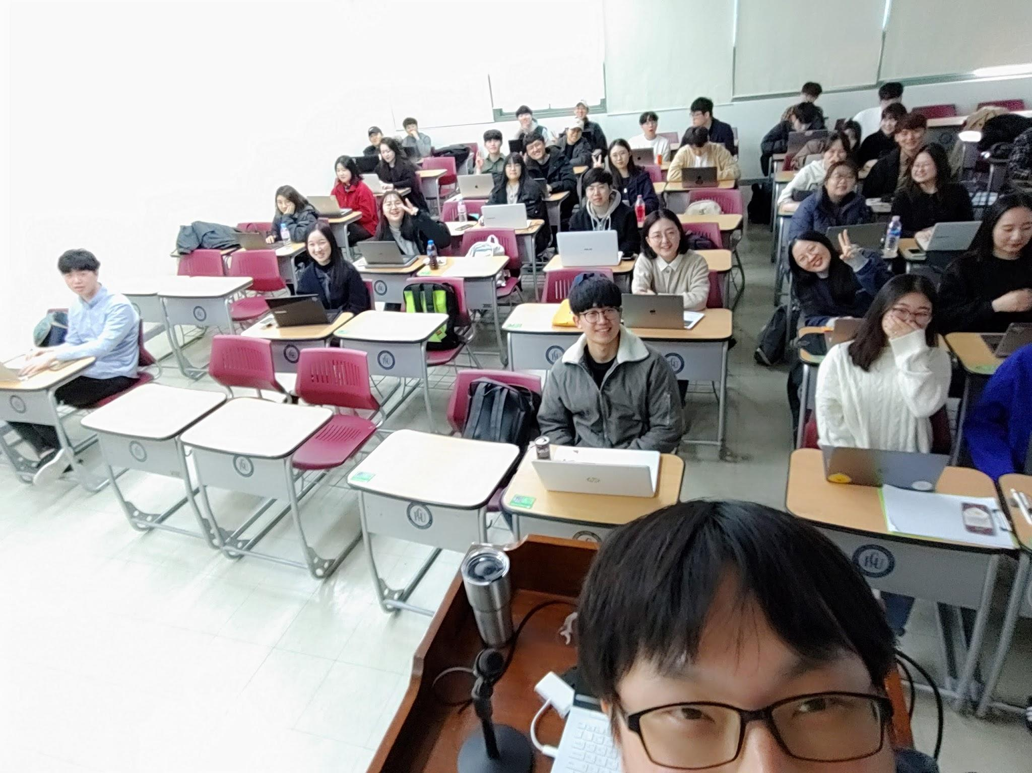
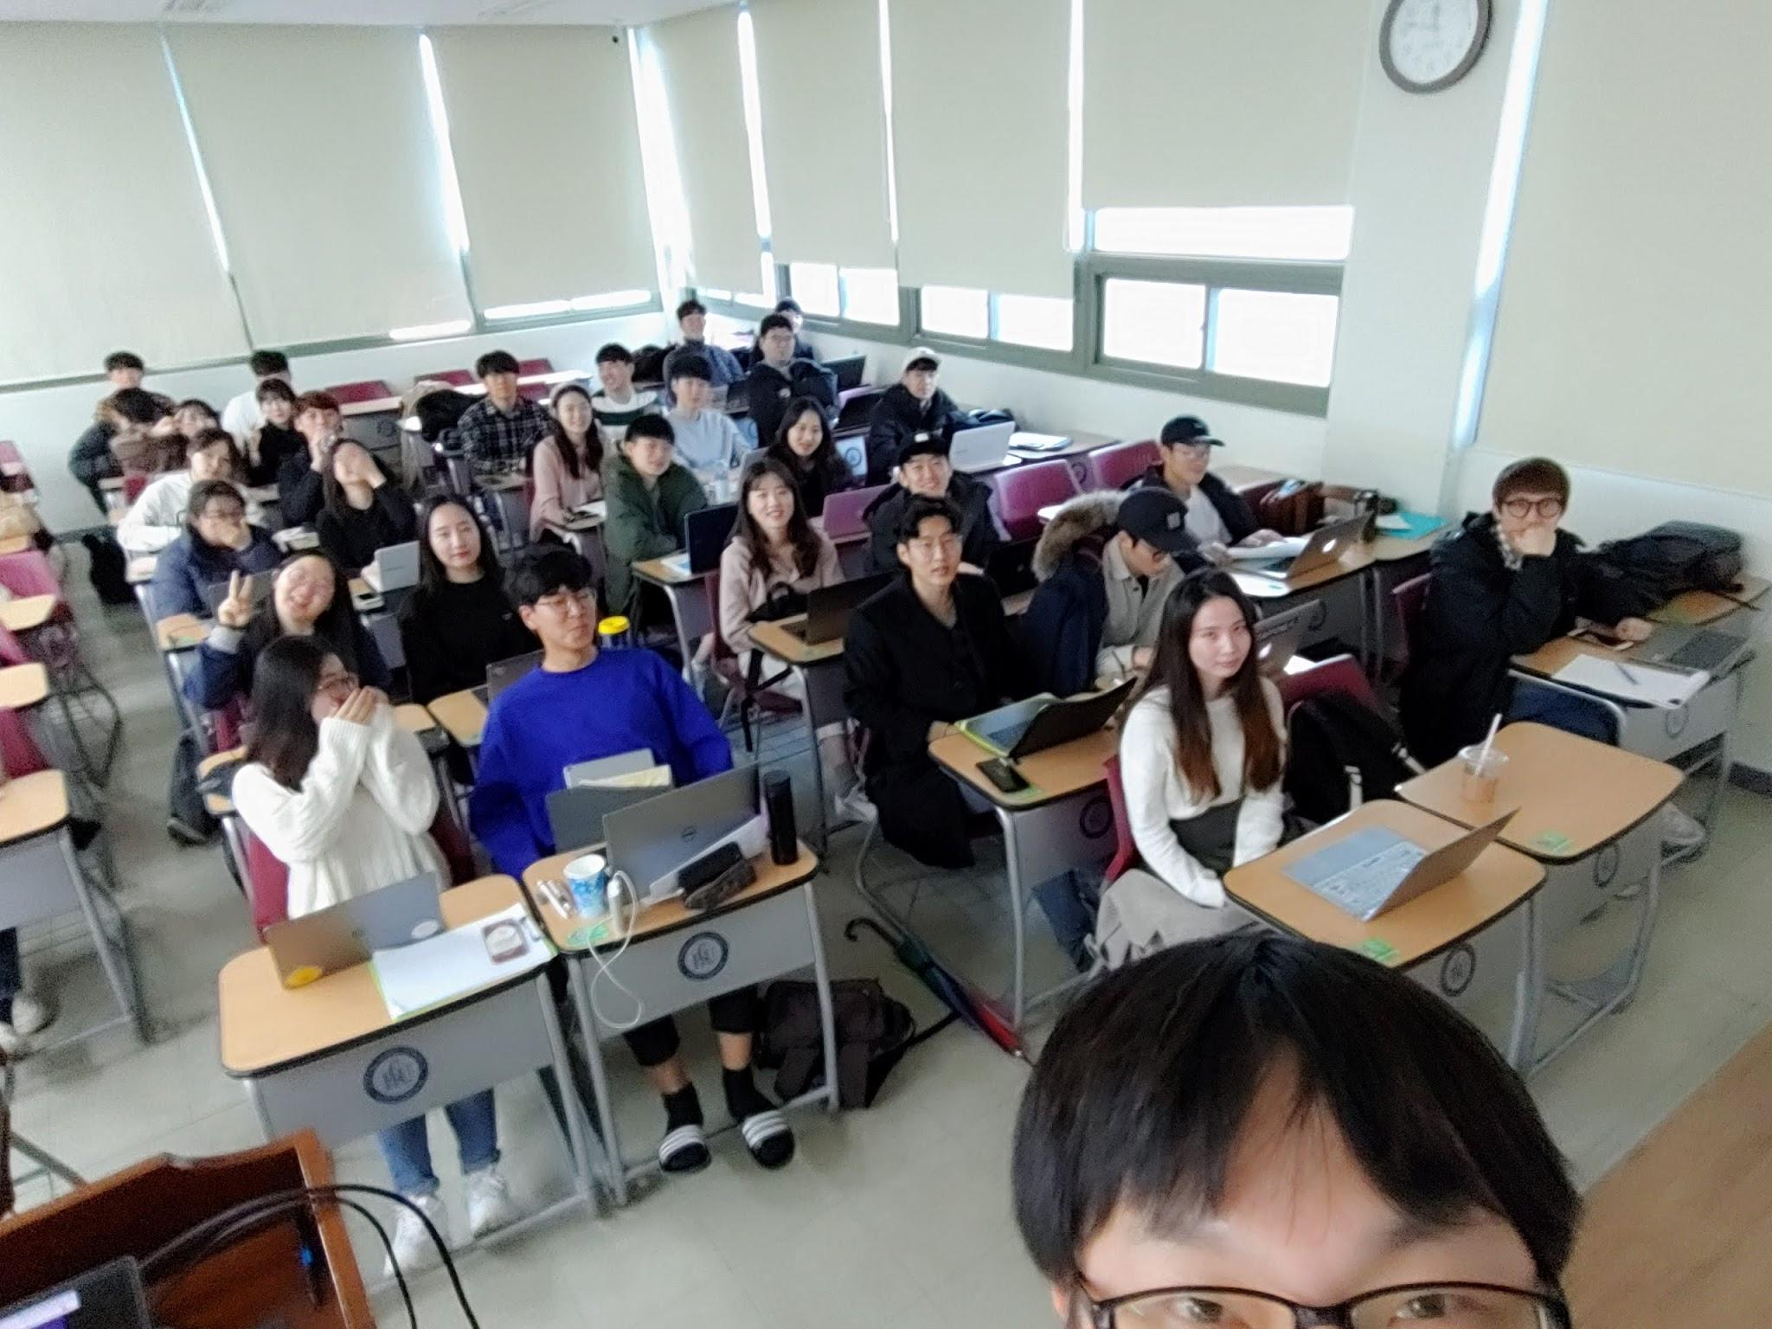
THANK YOU!!!
JC jcnam@handong.edu https://lifove.github.io
* Slides are from Prof. Sukyoung Ryu's PL class in 2018 Spring or created by JC based on the main text book.

